Slide 1
COCOMO II
- Values of COCOMO I
- Formula for effort in COCOMO II
- Scale Drivers
- Cost Drivers
- Calculation
- Comparison of the results

Slide 2
Values of COCOMO I
- FP = 48
- LOC = 2544 / KLOC = 2,544
- Effort(person month) = 6,4
- Development time(month) = 5,06

Slide 3
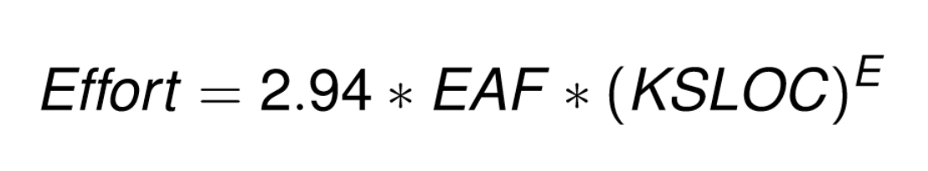
Formula for Effort in COCOMO II

Slide 4
Scale Drivers & Cost Drivers
http://sunset.usc.edu/research/COCOMOII/expert_cocomo/drivers.html

Slide 5
Calculation
http://csse.usc.edu/tools/COCOMOII.php

Slide 6
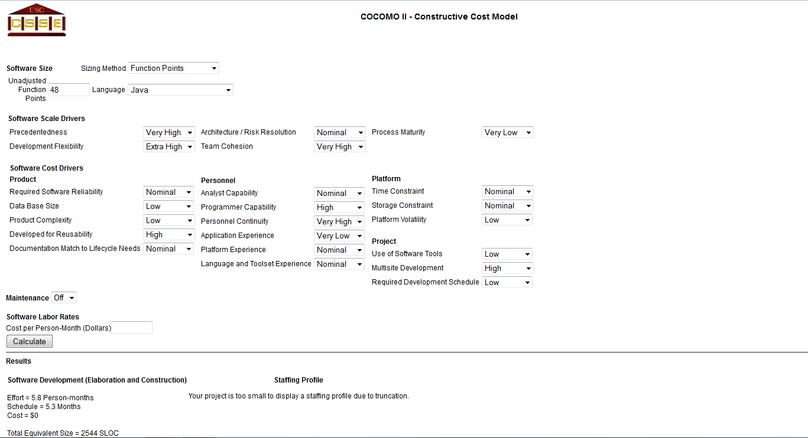

Slide 7
Comparison of the results
COCOMO I | COCOMO II
Effort = 6,4 person month | Effort = 5,8 person month
Development time = 5,06 month | Development time = 5,3 month

